Slide 1

Chandigarh School of Business, Jhanjeri
Department of Computer Application
Program Code:NA
Program Name: MCA
Course Code: PGCA1937
Course Name: Cloud Computing
Prepared by: Dr. Gurvir Kaur

Slide 2

Outlines
PTU Syllabus of Unit-I
CO’s Introduction
Topic Overview
Brief description of what the presentation will cover
Importance or relevance of the topic
Key objectives or learning outcomes
Summary
References

Slide 3
PTU Syllabus of Unit-I
Part-A
Overview of Computing Paradigm: Recent trends in Computing -Grid Computing, Cluster Computing, Distributed Computing, Utility Computing, Cloud Computing.
Introduction to Cloud Computing: Vision of Cloud Computing, Defining a Cloud, Cloud Reference Model, Deployment Model, Characteristics, Benefits of Cloud Computing, Challenges ahead. Cloud computing vs. Cluster computing vs. Grid computing.
Migrating into a Cloud: Introduction, Broad approaches to Migrating into the Cloud, The Seven-Step Model of Migration Into a Cloud.
Virtualization: Introduction, Characteristics of Virtualized environment, Taxonomy of Virtualization techniques, Virtualization and Cloud Computing, Pros and Cons of Virtualization, Technology Examples- Xen, VMware, Microsoft Hyper-V.
Capacity Planning: Introduction, Defining Baseline and Metrics-Baseline Measurements, System Metrics, Load Testing, Resource Ceilings, Server and Instance types; Network Capacity, Scaling.

Slide 4
Key objectives or learning outcomes
CO1 Understand the basic concept and importance of cloud computing.
CO2 Access the suitability of migrating to a cloud solution for different applications.
CO3 Compare and evaluate the virtualization technologies.
CO4 Monitor and manage the cloud resources, applications and data while addressing the security concerns.
CO5 Use cloud solutions offered by industry leaders for various applications.

Slide 5
CO Introduction
CO NUMBER | TOPICS | LEVEL
CO1 | Overview of Computing Paradigm: Recent trends in Computing -Grid Computing, Cluster Computing, Distributed Computing, Utility Computing, Cloud Computing. Introduction to Cloud Computing: Vision of Cloud Computing, Defining a Cloud, Cloud Reference Model, Deployment Model, Characteristics, Benefits of Cloud Computing, Challenges ahead. Cloud computing vs. Cluster computing vs. Grid computing. | 2

Slide 6
Topic Overview
Evolution and Integration: Recent trends in computing, such as Grid Computing, Cluster Computing, and Distributed Computing, focus on optimizing resource utilization across multiple systems.
These paradigms enable parallel processing and resource sharing, improving performance, scalability, and fault tolerance.
Grid Computing uses distributed resources to solve complex tasks, Cluster Computing groups tightly coupled systems for enhanced performance, and Distributed Computing splits workloads across geographically dispersed networks.

Slide 7
Brief of what the presentation will
The presentation will cover the following points:
Trends in Computing
Distributed Computing
Need
Applications

Slide 8
Importance of the topic
Scalability and Flexibility: Cloud computing provides on-demand access to a vast range of resources, enabling businesses to scale up or down based on their needs.
Cost Efficiency: By using cloud services, businesses can significantly reduce costs associated with maintaining and upgrading physical hardware.
Accessibility and Collaboration: Cloud computing allows users to access data and applications from any device with an internet connection, facilitating remote work and global collaboration. This enhances productivity, supports flexible work environments, and enables real-time collaboration across teams and locations.

Slide 9
Detail Topics
The ACM Computing Curricula 2005 defined "computing" as
"In a general way, we can define computing to mean any goal-oriented activity requiring, benefiting from, or creating computers. Thus, computing includes designing and building hardware and software systems for a wide range of purposes; processing, structuring, and managing various kinds of information; doing scientific studies using computers; making computer systems behave intelligently; creating and using communications and entertainment media; finding and gathering information relevant to any particular purpose, and so on. The list is virtually endless, and the possibilities are vast."

Slide 10
Detail Topics
Distributed computing refers to a computing model in which a system consists of multiple independent computers, or nodes, that work together to achieve a common goal.
These computers are connected via a network and collaborate by sharing tasks and resources, with each node performing a specific part of the overall computation.
The nodes may be geographically dispersed and operate autonomously, but they communicate and coordinate to solve problems or process data.
In distributed computing, the workload is divided into smaller chunks and distributed across various machines (sometimes referred to as workers or nodes). These nodes can either be in the same physical location or spread across different locations globally.
The main idea is to combine the processing power of multiple computers to handle large tasks more efficiently than a single machine could on its own.

Slide 11
Why Distributed Computing?
Nature of application
Performance
  Computing intensive
    The task could consume a lot of time on computing. For example, Computation of Pi value using Monte Carlo simulation
  Data intensive
    The task that deals with a large amount or large size of files. For example, Facebook, LHC(Large Hadron Collider) experimental data processing.
Robustness
  No SPOF (Single Point Of Failure)
  Other nodes can execute the same task executed on failed node.

Slide 12
Distributed applications
Applications that consist of a set of processes that are distributed across a network of machines and work together as an ensemble to solve a common problem
In the past, mostly “client-server”
  Resource management centralized at the server
“Peer to Peer” computing represents a movement towards more “truly”
distributed applications

Slide 13
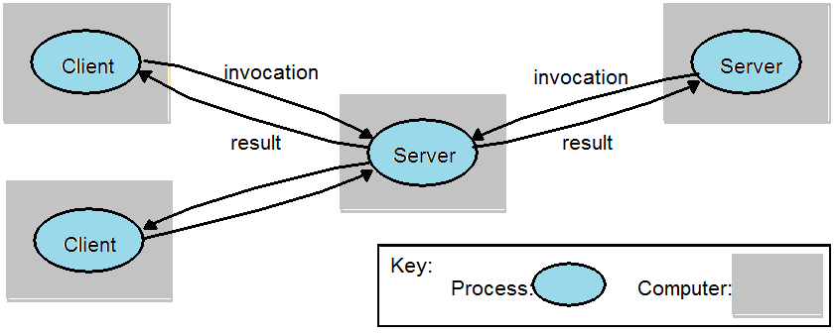
Clients invoke individual servers

Slide 14
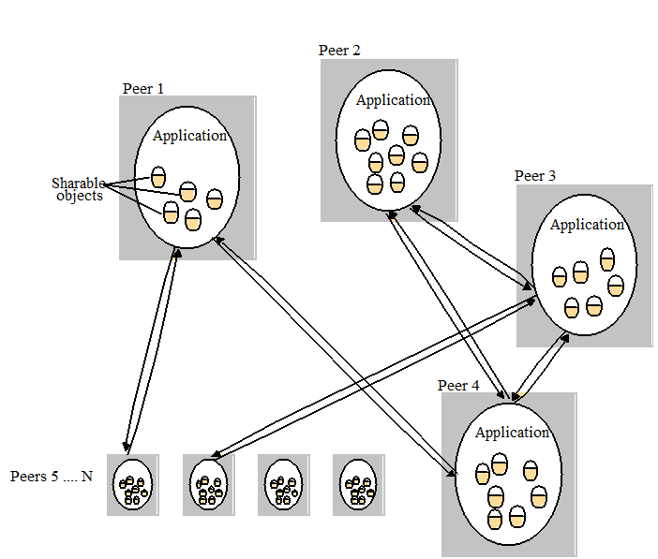
A typical distributed application based on peer processes

Slide 15
Summary
Distributed computing involves multiple independent computers (often located in different physical locations) working together to solve a problem. These computers communicate over a network, sharing tasks and resources to complete computations more efficiently.
It offers benefits like scalability, resource sharing, fault tolerance, and improved performance. By distributing tasks, it allows handling large, complex problems that would be difficult for a single machine to manage, and it ensures reliability by allowing the system to continue functioning even if some nodes fail.
Distributed computing is used in various fields, including cloud computing, big data analytics, scientific simulations, and collaborative platforms.

Slide 16
References
Books References
Mastering Cloud Computing, Rajkumar Buyya, Christian Vecchiola, and ThamaraiSelvi, Tata McGraw Hill, ISBN-13: 978-1-25-902995-0, New Delhi, India,Feb 2013.
E-book link
https://archive.org/details/cloudcomputingbi0000sosi
YouTube link
https://www.youtube.com/@cloudcomputing351/videos
https://www.geeksforgeeks.org/cloud-computing/
https://www.tutorialspoint.com/cloud_computing/index.htm
https://nptel.ac.in/courses/106105167
https://www.edx.org/learn/cloud-computing

Slide 17
THANK YOU

